Slide 1
Practical Messaging
A 101 guide to messaging

Slide 2
Who are you?
Software Developer for over 20 years
Worked mainly for ISVs
Reuters, SunGard, Misys, Huddle
Worked for a couple of MIS departments
DTI, Beazley
Microsoft MVP for C#
Interested in OO design
Interested in Agile methodologies and practices
No smart guys
Just the guys in this room

Slide 3
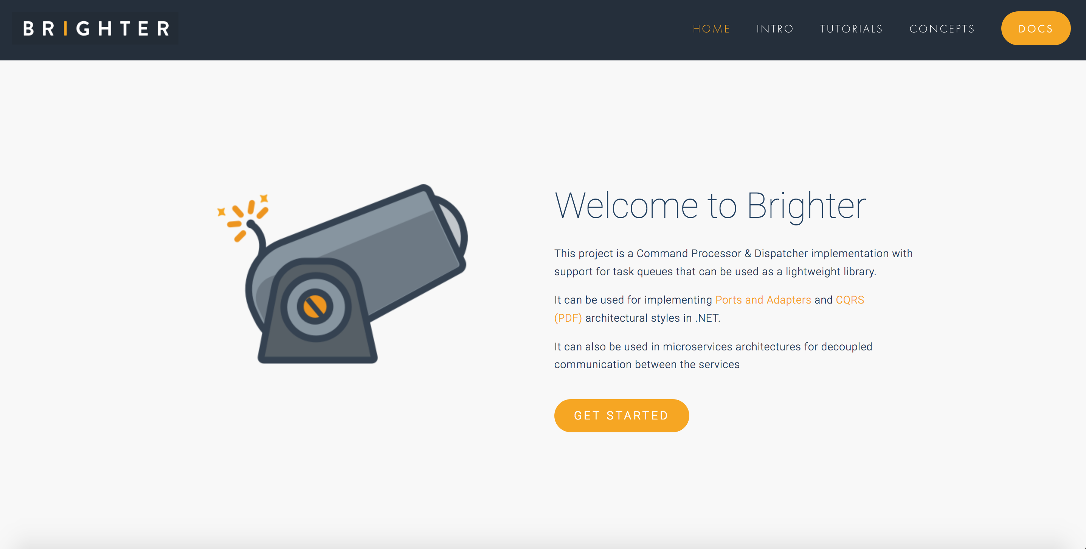

Slide 4
Day One Agenda
The Why of Messaging
Integration Styles
Why Prefer Messaging
Decoupled Invocation
Fundamental Messaging Patterns
Types of Messages
Channels
Endpoints

Slide 5
When do you get to write code?
When we get to messaging patterns, hopefully by the afternoon of Day One and then into the morning of Day Two

Slide 6
Prerequisites
We will use Rabbit MQ for examples. Either you need to have RMQ installed on your machine, or you should have Docker installed on your machine, as exercises provide a Docker Compose file to spin up RMQ.
You will need to be able to author C# or Python, with an editor/IDE of your choice.
You will need Python 3 and .NET Core

Slide 7
Exercise Code
https://github.com/iancooper/Practical-Messaging-Sharp
https://github.com/iancooper/Practical-Messaging-Python

Slide 8
Day One

Slide 9
1. The Why of messaging
Choosing messaging over other styles

Slide 10
Distributed Systems
Performance and Scalability
Availability
Maintainability
Inherent Distribution
Notes:
Distributed Systems 5m
Once upon a time computer systems were stand-alone, they ran on one-machine. But modern design tends to be distributed with parts running on different computing nodes. Why?
Performance and scalability: As systems become successful it becomes necessary to scale them to meet demand with adequate performance. With a distributed system we can scale-out by introducing new nodes and spread load, and we can also scale up parts of our offering to improve performance by making more expensive hardware available.
Availability: The problem of 'one' plagues computing. If I have 'one' computing node then failure stops my system running. But if we have redundant computing nodes we can rely on those nodes to provide service - perhaps degraded, until we can replace the node. This makes systems fault tolerant.
Maintainability: It becomes hard to maintain large monolithic systems: if you have to test the whole system in order to release it testing becomes an obstacle to release, often slowing release schedules and creating inventory waste; developers find it hard to grasp the 'whole', it's too big to reason about effectively. This often creates a 'banyan tree' anti-pattern with multiple solutions to the same problem, duplication, and if coupling is bad a 'big ball of mud'. Splitting a system into parts creates components that can be developed, QA'd and released independently reducing the problem of complexity to a more manageable size, improving our ability to reason about software, shortening the time to QA software and reducing inventory waste.
Inherent distribution: Some applications are inherently distributed such as business systems that span company divisions in multiple regions of the world, peer-to-peer content sharing etc.

Slide 11
Integration vs. Distribution
An n-tier system is distributed, but not integrated
A distributed system tends to use synchronous communication because the parts are not independent
An integrated system can often use asynchronous communication because the applications are independent
Notes:
Integration vs. Distribution
An n-tier system is distributed, but not integrated
A distributed system tends to use synchronous communication because the parts are not independent when delivering functionality to the user and are thus sensitive to response times
An integrated system can often use asynchronous communication because the applications are independent of each other and each can function without the other — allowing one to hand off to another without the expectation of timing of the result
[Worth noting that in the Fred George school of micro services, many of the services are ’tiers’ of a distributed application, broken out, hence gRPC whereas in Fowler/Lewis SOA school the parts are independent and so can tend to interoperate asynchronously]

Slide 12
Integration Problems
Notes:
Integration Problems
Networks are Unreliable
Networks are Slow
Any two applications are different [language, platform, data format]
Change is inevitable [Favour Loose Coupling]

Slide 13
The network is reliable.
Latency is zero.
Bandwidth is infinite.
The network is secure.
Topology doesn't change.
There is one administrator.
Transport cost is zero.
The network is homogeneous.
Notes:
Networks are Unreliable
The effects of the fallacies
Software applications are written with little error-handling on networking errors. During a network outage, such applications may stall or infinitely wait for an answer packet, permanently consuming memory or other resources. When the failed network becomes available, those applications may also fail to retry any stalled operations or require a (manual) restart.
Ignorance of network latency, and of the packet loss it can cause, induces application- and transport-layer developers to allow unbounded traffic, greatly increasing dropped packets and wasting bandwidth.
Ignorance of bandwidth limits on the part of traffic senders can result in bottlenecks over frequency-multiplexed media.
Complacency regarding network security results in being blindsided by malicious users and programs that continually adapt to security measures.^{[2]}
Changes in network topology can have effects on both bandwidth and latency issues, and therefore similar problems.
Multiple administrators, as with subnets for rival companies, may institute conflicting policies of which senders of network traffic must be aware in order to complete their desired paths.
The "hidden" costs of building and maintaining a network or subnet are non-negligible and must consequently be noted in budgets to avoid vast shortfalls.
If a system assumes a homogeneous network, then it can lead to the same problems that result from the first three fallacies.
History
The list of fallacies generally came about at Sun Microsystems. L. Peter Deutsch, one of the original Sun "Fellows", is credited^{[by whom?]} with penning the first seven fallacies in 1994; however, Bill Joy and Tom Lyon had already identified the first four as "The Fallacies of Networked Computing"^{[3]} (the article claims "Dave Lyon", but this is a mistake^{[why?]}). Around 1997, James Gosling, another Sun Fellow and the inventor of Java, added the eighth fallacy.^{[3]}

Slide 14
Any two applications are different
Notes:
Language, Platform, Data format
Not necessarily by accident. The ‘microservices dividend’ may in fact mean that it is desirable for different parts of our application to be written in different languages

Slide 15
Change is inevitable
Notes:
Favour Loose Coupling
You may change where something is located. You may change how something is implemented. You may have new requirements to integrate with new services including new third party applications. You may want to develop new applications. You may pivot and need

Slide 16
1.1 Integration styles
Building Distributed Systems

Slide 17
File Transfer
Two processes communicate via the Producer writing to a file, and the Consumer reading from it.
A common data transfer mechanism that can be used by a variety of languages and platforms and feels neutral towards each
Requires agreement: file names, locations, who manages files
Will create eventual consistency between systems due to periodic nature of publication
Notes:
File Transfer
A common data transfer mechanism that can be used by a variety of languages and platforms and feels neutral towards each
All OSs and languages tend to support reading files
We need to agree format
Produced at an interval (Weekly, Nightly, Hourly…)
No need to understand internals of applications
Requires agreement: file names, locations, who manages files
Needs locking
Will create eventual consistency between systems due to periodic nature of publication
At higher frequency of production, management of files means we tend to switch to messaging
Integrates data but not functionality.

Slide 18
Shared Database
Two processes communicate by the Producer writing to a database and the consumer reading from it.
Creating a unified schema that can meet the needs of all applications is a challenge
Breaks encapsulation and causes change to ripple across all applications
Often the Db supporting many enterprise-wide applications becomes the bottleneck
Notes:
Shared Database
Removes timing, format and locking issues inherent in File Transfer
Creating a unified schema that can meet the needs of all applications is a challenge
Delays in cross-team projects caused by unified schema issues tend to push fragmentation
Often the Db supporting many enterprise-wide applications becomes the bottlneck with so many systems writing to it
You are, in effect, multi-tenant with other applications and can suffer from the ‘noisy neighbour’ issue
Breaks encapsulation and causes change to ripple across all applications
May cause ‘resistance to change’ and failure to meet the needs of the business
Integrates data but not functionality.

Slide 19
Remote Procedure Call
Two processes communicate by the client causing a procedure to execute in another address space belonging to the server, coded as if it were a local call.
Integrates functionality not data
Behavioral coupling can tie the systems together in a knot, particularly due to sequencing
Notes:
Remote Procedure Invocation
Integrates functionality not data
RPC preserves encapsulation — you call my shared business function - and allows each application to preserve integrity of its internals
Each application can now change independently
Allows LMI syntax for RMI
This is a disadvantage [Waldo]
Behavioural coupling can tie the systems together in a knot, particularly due to sequencing
is an issue of not understanding that as RMI is not LMI design needs to be different to be effective

Slide 20
Messaging
Two processes communicate by the Producer sending a packet of data to a channel and the Sender reading that packet of data from the channel.
Asynchronous communication does not require both systems to be up and ready at the same time.
Messages can be transformed in transit without sender or receiver knowing
Small messages frequently allows behavioral as well as data collaboration
Notes:
Messaging
Loosely coupled integration.
Asynchronous communication is a fundamentally pragmatic reaction to the problems of distributed systems. Sending a message does not require both systems to be up and ready at the same time. Furthermore, thinking about the communication in an asynchronous manner forces developers to recognise that working with a remote application is slower, which encourages design of components with high cohesion (lots of work locally) and low adhesion (selective work remotely).
Allow decoupling: messages can be transformed in transit without sender or receiver knowing
This allows sender and receiver to have different conceptual models
Small messages frequently allows behavioral as well as data collaboration
Even so eventual consistency remains an issue

Slide 21
1.2 What is RPC?
Let’s talk about messaging’s big rival.

Slide 22
RFC 707 “A High-Level Framework for Network-Based Resource Sharing” describes Remote Procedure Calls (RPC).
Authored by James White in 1976
Notes:
Paper written in 1976 when most of the protocols for inter-process communication were oriented around a human being typing commands, and often part of batch processes. These inter-process communication protocols all had their own unique protocol forcing users to become familiar with a wide range of protocols when orchestrating software.

Slide 23
White identified that many of the protocols in use for inter-process communication (IPC) such as File Transfer Protocol (FTP), or Remote Job Execution (RJE) had a common: Command-Response pattern.
Notes:
All of these protocols have a similar approach. You issue a command, with come parameters, and you get a response back with a code for success or error. Although all used different names White identified that this pattern, which he called Command-Response was common to all of them.
White identified that Command-Response was the application-independent protocol: it was the pattern which all of the independent protocols followed.

Slide 24
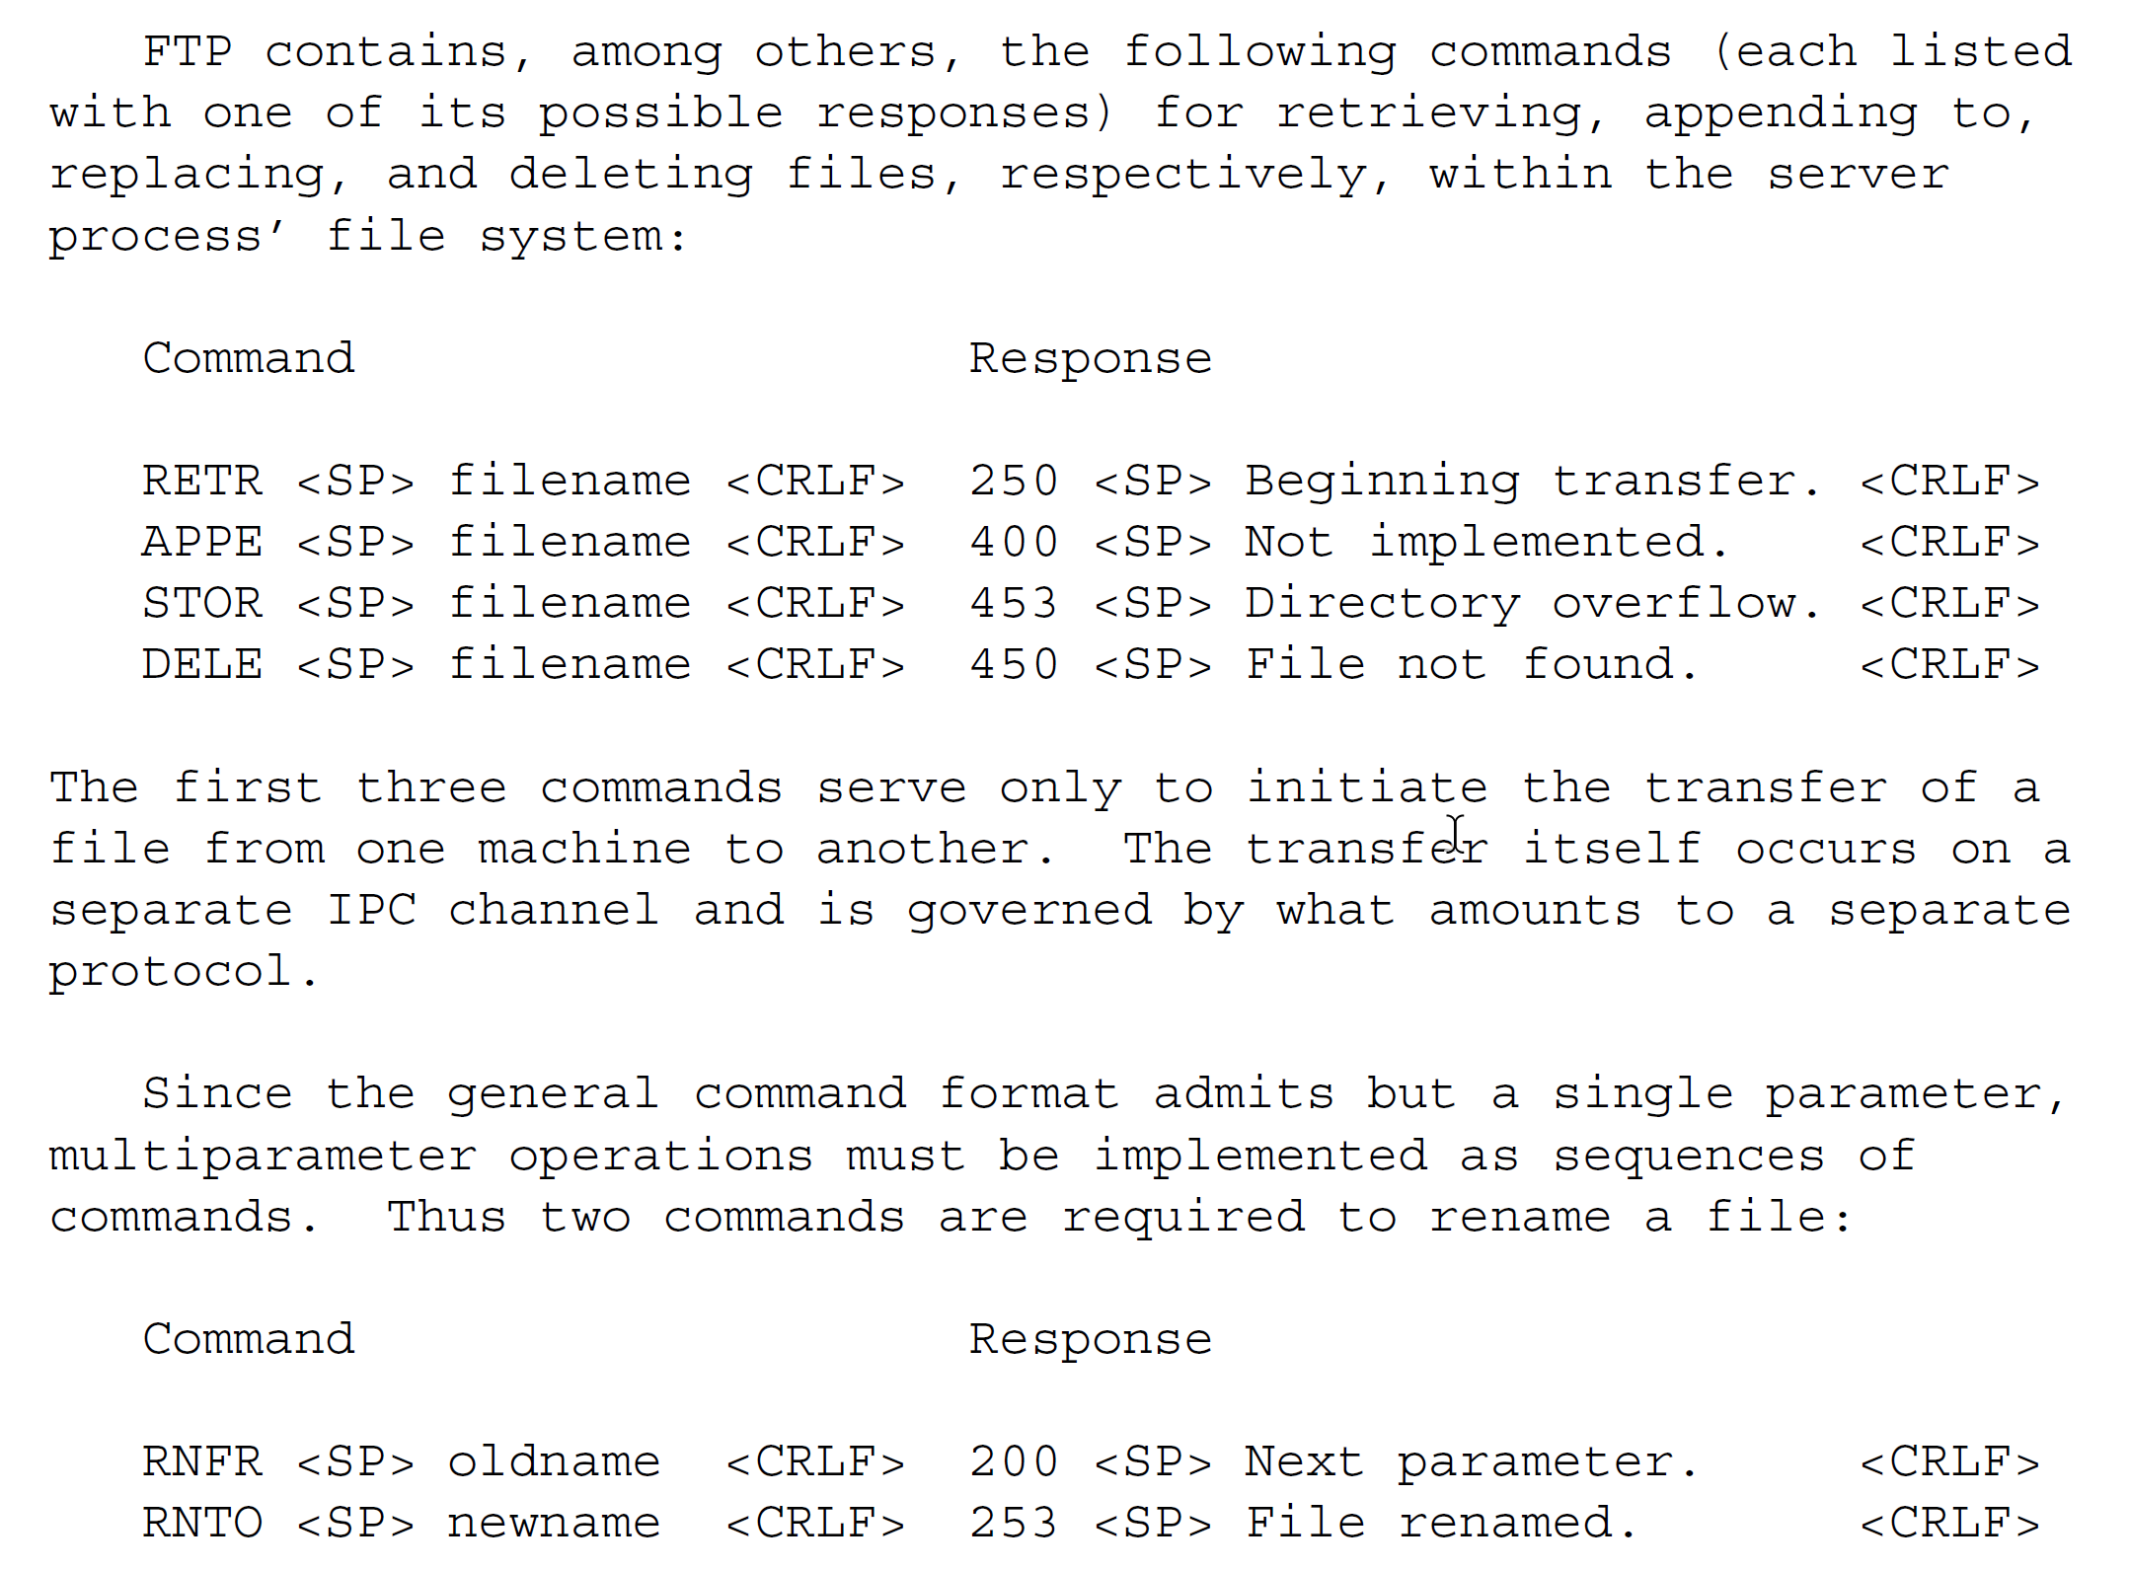
RFC 707 – James White

Slide 25
command-name <SP> parameter <CRLF>
response-number <SP> text <CRLF>
Notes:
FTP and RJE (Remote Job Execution have a common format)
This common command/response discipline requires that commands and responses have the following respective formats:
command-name <SP> parameter <CRLF>
response-number <SP> text <CRLF>
For example FTP has RETR <filename> or DEL <filename>
Each command invoked by the user process is identified by NAME and is allowed a single PARAMETER. Each response generated by the
server process contains a three-digit decimal response NUMBER (to be interpreted by the user process) and explanatory TEXT (for
presentation, if necessary, to the user). Response numbers are assigned in such a way that, for example, positive and negative
acknowledgments can be easily distinguished by the user process.

Slide 26
White argued that instead of application specific protocols the key to distributed computing was a protocol that supported command-response between two processes, allowing the user process to execute commands on the host.
Notes:
Instead of dealing with individual protocols I can have a library, for each programming language I need to use, that supports sending a command with parameters and receiving a response with either errors or text. Yes, each application has to define its own vocabulary of commands, but the grammar remains the same. As a developer I only need to learn how to use one library.
A single run-time environment constructed; a library per programming language to use that runtime; standard-approach, allowing interop

Slide 27
COMMAND [tid] command-name arguments
RESPONSE tid outcome results
Notes:
COMMAND-RESPONSE
The first message invokes the command whose NAME is specified using the ARGUMENTS provided. The second is issued in eventual response to the first and returns the OUTCOME and RESULTS of the completed command. Whenever OUTCOME indicates that a command has failed, the command’s RESULTS are required to be an error number and diagnostic message, the former to help the invoking program determine what to do next, the latter for possible presentation to the user. The protocol thus provides a framework for reporting errors, while leaving to the applications program the tasks of assigning error numbers and composing the text of error messages.

Slide 28
REQUEST [tid] op-code arguments
REPLY tid outcome results
Notes:
REQUEST-REPLY
While the command/response model is a natural one, others are possible. A remote resource might also be modeled as a process that services and replies to requests it receives from other computer processes. This request/reply model would emphasize the fact that the Protocol is a vehicle for inter-process communication and that no human user is directly involved.
Substituting the request/reply model for the command/response model requires only cosmetic changes to the Protocol:
message-type=REQUEST [tid] op-code arguments
message-type=REPLY tid outcome results
In the formulation above, the terms "REQUEST", "REPLY", and "op-code" have simply been substituted for "COMMAND", "RESPONSE", and "command-name", respectively.
The choice of model need affect neither the content of the Protocol nor the behavior of the processes whose dialog it governs.
Use of the word "command" in the command/response model, for example, is not meant to imply that the remote process can be coerced into action. Whatever model is adopted, a process has complete freedom to reject an incoming remote request that it is incapable of or unwilling to fulfill.

Slide 29
CALL [tid] procedure-name arguments
RETURN tid outcome results
Notes:
PROCEDURE-CONTROL-PROTOCOL (PCP)
Ideally, the goal of both the Protocol and its accompanying RTE is to make remote resources as easy to use as local ones. Since local resources usually take the form of resident and/or library
subroutines, the possibility of modeling remote commands as "procedures" immediately suggests itself. The Model is further confirmed by the similarity that exists between local procedures and
the remote commands to which the Protocol provides access. Both carry out arbitrarily complex, named operations on behalf of the requesting program (the caller); are governed by arguments supplied by the caller; and return to it results that reflect the outcome of the operation. The procedure call model thus acknowledges that, in a network environment, programs must sometimes call subroutines in machines other than their own.
Like the request/reply model already described, the procedure call model requires only cosmetic changes to the Protocol:
message-type=CALL [tid] procedure-name arguments
message-type=RETURN tid outcome results
In this third formulation, the terms "CALL", "RETURN", and "procedure-name" have been substituted for "COMMAND, "RESPONSE", and "command-name", respectively. And in this form, the Protocol might aptly be designated a "procedure call protocol (PCP)"

Slide 30
White called this: Procedure Control Protocol (PCP) though we would now call it Remote Procedure Call (RCP)

Slide 31
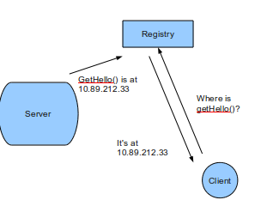
The key principle is that that a remote procedure call should be ‘as close as possible to local (single-machine) procedure calls.
A client should not need to know the location of the server.
Location Transparency

Slide 32
Interface Definition Language
The idea of an Interface Definition Language separates compilation and binding through interface modules
RPC frameworks use these modules to generate stubs for the caller and receiver.
Notes:
COM and CORBA’s IDL, WSDL for SOAP, protobuf for gRPC
RPCRuntime is a standard part of the Cedar system. The user and server are written as part of the distributed application. But the user-stub and server-stub are automatically generated, by a program called Lupine.
This generation is specified by use of Mesa interface modules. These are the basis of the Mesa (and Cedar) separate compilation and binding mechanism [9]. An interface module is mainly a list of procedure names, together with the types of their arguments and results. This is sufficient information for the caller and callee to independently perform compile-time type checking and to generate appropriate calling sequences.
A program module that implements procedures in an interface is said to export that interface. A program module calling procedures from an interface is said to import that interface. When writing a distributed application, a programmer first writes an interface module. Then he can write the user code that imports that interface and the server code that exports the interface. He also presents the interface to Lupine, which generates the user-stub, (that exports the interface) and the server-stub {that imports the interface). When binding the programs on the 'caller machine, the user is bound to the user-stub. On the callee machine, the server-stub is bound to the server.
(protobuf based) are all just modern implementations of this idea.

Slide 33
Service Registration & Discovery
If the call looks like a local procedure call, how do we know where the server is that will service the request?
You need to register services via a distributed key-value store.
The server runtime exports its interface names, along with server name and network location. i.e. service registration
A client requests from the runtime servers that provide the interface and then routes the request (in this case to the closest) i.e. service discovery
Notes:
Also created the idea of service discovery. To make this seamless the programmer doesn’t want to understand that they are making a network call, so how does the runtime make the call? The simple answer is that we need to register processes that can provide given procedures and allow the runtime to lookup those instances when it needs to make a call and route the call to an available instance. The client developer doesn’t need to be aware of the address of the server – the runtime needs to be aware of the server.
Now: etcd, zookeeper, consul are used for service registration and discovery. The Windows Registry is a key value store that provided the same functionality for COM. But it was not distributed
You need to register services via a distributed key-value store.
The server runtime exports its interface names, along with server name and network location. i.e. service registration
A client requests from the runtime servers that provide the interface and then routes the request (in this case to the closest) i.e. service discovery

Slide 34
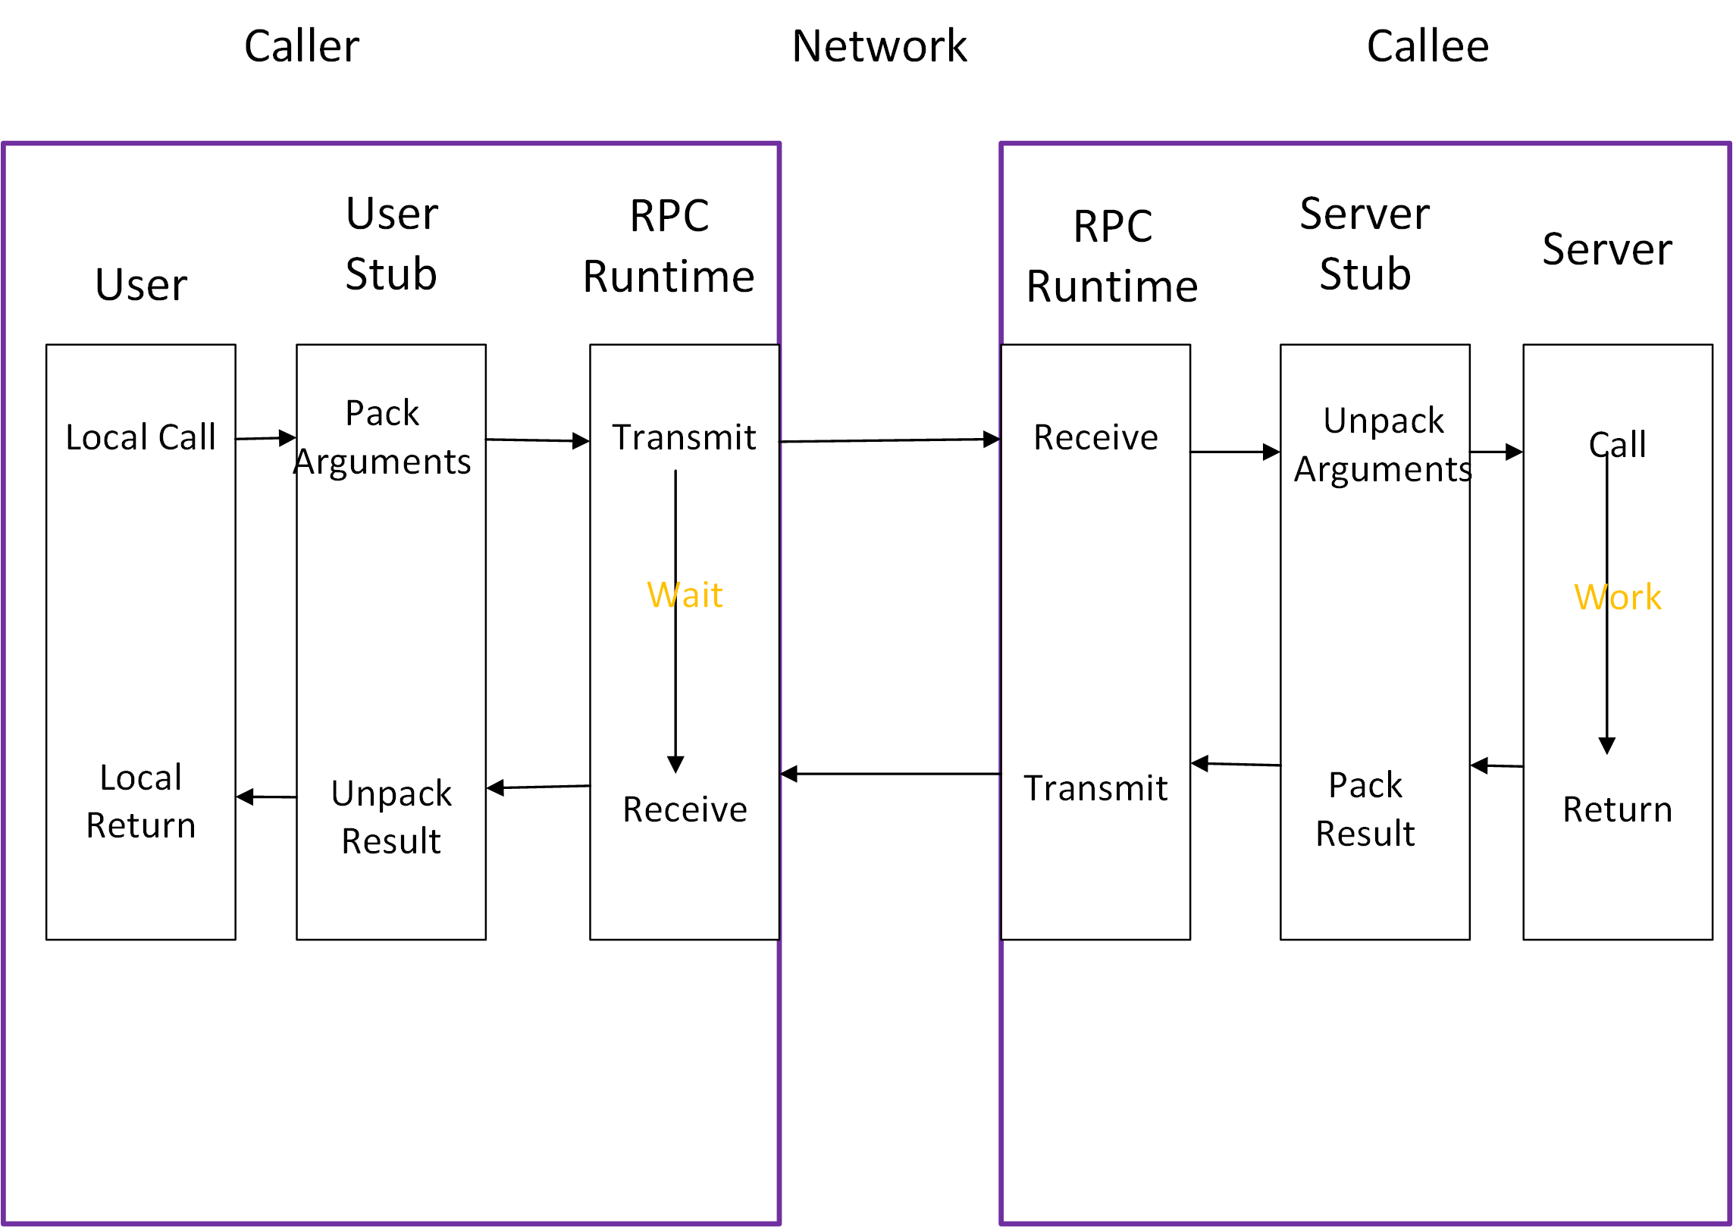
Notes:
The program structure we use for RPC is similar to that proposed in Nelson' thesis. It is based on the concept of stubs.
When making a remote call, five pieces of program are involved: the user, the user-stub, the RPC communications package (known as RPC Runtime), the server-stub, and the server.
Their relationship is shown in Figure 1. The user, the user-stub, and one instance of RPC Runtime execute in the caller machine; the server, the server-stub and another instance of RPC Runtime execute in the callee machine.
When the user wishes to make a remote call, it actually makes a perfectly normal local call which invokes a corresponding procedure in the user-stub. The user-stub is responsible for placing a specification of the target procedure and the arguments into one or more packets and asking the RPC Runtime to transmit these reliably to the callee machine.
On receipt of these packets, the RPC Runtime in the callee machine passes them to the server-stub.
The server-stub unpacks them and again makes a perfectly normal local call, which invokes the appropriate procedure in the server. Meanwhile, the calling process in the caller machine is suspended awaiting a result packet. When the call in the server completes, it returns to the serverstub and the results are passed back to the suspended process in the caller machine. There they are unpacked and the user-stub returns them to the user.
RPC Runtime is responsible for retransmissions, acknowledgments, packet routing, and encryption.
Apart from the effects of multimachine binding and of machine or communication failures, the call happens just as if the user had invoked the procedure in the server directly. Indeed, if the user and server code were brought into a single machine and bound directly together without the stubs, the program would still work.

Slide 35
Temporal Coupling
Notes:
The server must be available when you call.
if I make a phone call, and you are not there I am shit out of luck. RPC is a phone call, direct communication between two participants and can be frustrating if you get a busy tone or no one answers. (nowadays we may leave an answer phone message, or send a text, but this is messaging not RPC). We will come to that later.
Pooling of resources can help here – one of anything can fail, so you need multiple servers
To avoid the client now having to know about where a server lives, which again defeats concept of RPC, then you have to use service-discovery in your runtime, so that location is hidden to caller. Good idea anyway, even if location transparency not our goal, not to have a fixed location.
Not true of decoupled invocation i.e. messaging of course.
“... the degree to which the sending and handling of a message are connected in time. If a sender is dependent on a receiver being available when a message is sent, we have high temporal coupling... Processes whose activities are strictly ordered or whose results carry forward, leaving subsequent activities unable to start until a response to a prior request has been received, are similarly temporally coupled. “ Ian Robinson

Slide 36
Request Driven Architecture
“HTTP request-response with resource API’s… Be of the web not behind the web ”
Fowler and Lewis
Direct
Bookings
Credit Card
Payments
Housekeeping
Channel Manager
API
API
API
API
Db
Db
Db
Db
Notes:
In a request driven architecture each service calls another services using a synchronous API such as HTTP or gRPC and awaits a response. One operation for a user of the site, may span multiple steps, which has latency.

Slide 37
Request Driven Architecture
Direct
Bookings
Credit Card
Payments
Housekeeping
Channel Manager
API
API
API
API
Db
Db
Db
Db
Notes:
Temporal coupling is the problem that in order for us to make a Direct Booking the Channel Manager needs to be working. If we cannot update the channels, we do not take the customer’s booking. But of course this is problematic (1) Our uptime for our Direct Bookings Service is the product of the uptime of all the services that it calls (2) The channel manager may depend on external channels that have low uptimes and if so our direct bookings service becomes only as available as the worst availability of our channels (in fact worse as it is the product).
And would the business prefer: we can take a booking but might risk over-booking because one of our channels offers a room that we have already sold, or that we don’t take any bookings because we cannot guarantee against over-booking. For most business it is arguably the former

Slide 38
Using A Proxy for Availability
We load balance the requests across multiple servers
Health Checks let us know who can we route to
Proxy
Proxy
Proxy
Direct
Bookings
Credit Card
Payments
The proxy can also support retry and or circuit breakers to help with availability
Housekeeping
Channel Manager
API
Credit Card
Payments
Housekeeping
Channel Manager
API
API
API
Credit Card
Payments
Housekeeping
Channel Manager
Db
Db
Db
Db
Notes:
By using a proxy we can load balance our request across a group of servers – thus reducing our dependency on any one service being up and thus improving our availability\
If the service exports a health check then we can ensure that we only route to servers that are up, and thus able to fulfill our requests
We can also make retry and circuit breaker orthogonal concerns here, eliminating transient errors and preventing a thundering herd when it does happen

Slide 39
Config
Discovery
Monitoring
Policy
Control Plane
Data Plane
Proxy
Proxy
Proxy
Proxy
Direct
Bookings
Credit Card
Payments
Housekeeping
Channel Manager
Direct
Bookings
Credit Card
Payments
Housekeeping
Channel Manager
API
API
API
API
Direct
Bookings
Credit Card
Payments
Housekeeping
Channel Manager
Db
Db
Db
Db
Notes:
If everything goes via a proxy, that proxy can be used as an interception point for centralizing services:
Configuration – we can dynamically provide configuration based on the runtime environment
Discovery – we can register new instances of services, allowing us to load balance across service instances
Monitoring – we can trace requests and provide visibility as to service health
Policy – authentication, TLS, rate limiting etc

Slide 40
Behavioral Coupling
Notes:
“...the degree to which parties share assumptions regarding behaviors, more specifically, to the implications of assigning the twin responsibilities for determining what action to execute and how to execute that action to the parties in a distributed interaction. In systems that exhibit an extremely high degree of behavioral coupling, the sender of a message determines what to do, and also knows something of how the receiver ought satisfy its request... High behavioral coupling requires a provider to evolve its service offerings in response to changed consumer requirements” Ian Robinson
Control coupling Control coupling is one module controlling the flow of another, by passing it information on what to do (e.g., passing a what-to-do flag).
The problem with a procedural style is that the client is the locus of control – it decides the calls and their sequence.
This means that domain knowledge, or expertise belongs to the client, not the server.
In OO we call this problem feature envy. The Law of Demeter applies.
Shouldn’t the server be the expert?

Slide 41
Change Happens
?
Cleaning
API
Direct
Bookings
Credit Card
Payments
Channel Manager
API
API
API
Db
Laundry
API
Db
Db
Db
Inventory
Db
API
Db
Notes:
If we decide that we need to make changes to our capability map – for example we begin to break down the Housekeeping service – realizing that it was a group that supported a number of capabilities

Slide 42
RPC: The Good

Slide 43
Without it, we are re-inventing the wheel in ad-hoc network programming
Notes:
Integrating Applications 5m
One of the issues for distributed systems is how we integrate the components together.
Ad hoc programming suffers from the need to solve a common set of problems around type marshaling, lifetime management, tight coupling of the code the socket API, and paradigm mismatches between low-level socket code and higher level OO frameworks.
RPC frameworks improve on this by providing a layer over the API that handles type marshaling, parameter matching, and exposing an OO abstraction over low-level code.

Slide 44
RPC: The Bad

Slide 45
Location Independence
Platform Coupling
Temporal Coupling
Behavioral Coupling
Synchronous Communication
Data Format
Connection-Oriented
Notes:
However RPC has its own issues because it does not resolve:
Location Independence: We would like clients to not have to know the location of a component which becomes particularly important if we want to redirect the client for performance or fault-tolerance
Platform Coupling: RPC tends to depend on both sender and receiver using the same platform, which may not always be possible, and means that we tie future change into what may be a 'legacy' technology
Temporal Coupling: RPC often requires us to make a series of calls to an interface to meet a requirement, and some calls must be made before others such as initializing the receiver. What is worse is that remote objects may depend on other objects and there is no mechanism for managing these dependencies, which means that developers must orchestrate these dependencies instead. This couples the client and receiver into a sequence of operations that must occur in sequence, which makes the software brittle to change.
Domain Coupling: One of our four tenets is to share schema not type - the problem with RPC is that it tends to share type, which bleeds the model of one domain into another. Now we can limit the damage here to some extent by using ideas like an anti-corruption layer to translate between models, but we are coupled to the types in the other system and will need to change if they change, if only to change out anti-corruption layer.
Synchronous Communication: RPC tends to depend on synchronous communication in which requests flow from clients and responses flow from the server. The problem here is that the client must create a session with the server to communicate, which does not easily allow fault-tolerance or publishing to multiple consumers at the same time. It also performs badly because the blocking call from the client ties up compute resources on the client whilst waiting on a response from the server.
Data Format: The client and server are bound by the ordering, type and number of parameters. If the server changes then the client will break. This forces us to to confirm client behavior by testing when we change the sender
Connection-Oriented: A connection-oriented protocol creates a session and then sends a stream of data between two applications in order. It is not fault tolerant as it assumes that the sender and receiver are both available at the same time. Defensive code becomes complicated bearing in mind that one of the components might not be available at the required time.
Trying to portray a remote communication as local-method invocation leads to trouble, because it elides from the developer the issues associated with a remote call.

Slide 46
1.3 What is messaging?
A high-level overview, much more later

Slide 47
High-speed, asynchronous, inter-process communication with reliable delivery

Slide 48
Processes communicate by sending packets of data called messages

Slide 49
Channels are logical pathways between processes
Notes:
A channel behaves like a distributed collection of messages
A sender or producer sends a message to a channel
A receiver or consumer receives a message by reading and deleting it from a channel

Slide 50
A message is a data structure
Notes:
It MAY be interpreted as data
It MAY be interpreted as a command to be invoked on the receiver
it MAY be interpreted as an event that occurred on the sender
It MAY consist of two parts, a header and a body

Slide 51
Messaging depends on Message-Oriented-Middleware (MOM)
Messaging depends on Message-Oriented-Middleware (MOM)
Routes messages between applications
Co-ordinates sending and receiving of messages
Sender and receiver have the same availability
Asynchronous: Send and Forget
Store and Forward
Notes:
Messaging depends on Message-Oriented-Middleware (MOM)
Routes messages between applications
Co-ordinates sending and receiving of messages
A messaging system overcomes issue with reliability - temporal coupling - as the sender and receiver have the same availability
Create
Send
Deliver
Receive
Process
Send and Forget
A sender does not block once the message reaches the MOM
Store and Forward
When the sending application sends, the MOM stores the message
Delivery can be retried until it succeeds
This is ‘guaranteed delivery’ and it overcomes temporal coupling

Slide 52

Event Driven Architecture
“Messaging over a lightweight message bus such as RabbitMQ”
Fowler and Lewis
Direct
Bookings
Credit Card
Payments
Housekeeping
Channel Manager
API
API
API
API
Consumer has no notion of producer, just a channel on tbe broker
Channels subscribes to a channel on the broker
Db
Db
Db
Db
Broker
Notes:
A service publishes an event to a broker – usually using a topic or similar identifier
A consumer subscribes to that topic on the broker and receives messages
The channel usually offers guaranteed at least once delivery avoiding the issue of temporal coupling

Slide 53
Event Driven Architecture
Channel provides guaranteed at least once delivery
Direct
Bookings
Credit Card
Payments
Housekeeping
Channel Manager
API
API
API
API
Db
Db
Db
Db
Broker
Notes:
A service publishes an event to a broker – usually using a topic or similar identifier
A consumer subscribes to that topic on the broker and receives messages
The channel usually offers guaranteed at least once delivery avoiding the issue of temporal coupling

Slide 54
Event Driven Architecture
Channel provides guaranteed at least once delivery
Direct
Bookings
Credit Card
Payments
Housekeeping
Channel Manager
API
API
API
API
Db
Db
Db
Db
Broker
Notes:
A service publishes an event to a broker – usually using a topic or similar identifier
A consumer subscribes to that topic on the broker and receives messages
The channel usually offers guaranteed at least once delivery avoiding the issue of temporal coupling

Slide 55
Event Driven Architecture
Direct
Bookings
Credit Card
Payments
The producer, Bookings, does not care that I split Housekeeping
Channel Manager
API
API
API
Cleaning
Laundry
API
API
Db
Db
Db
Db
Db
Broker

Slide 56
Messaging: The Good

Slide 57
Platform independent data format
Sent to an addressable channel
Supports data transformations
Remote Communication
Platform/Language Integration
Asynchronous Communication
Throttling
Reliable Communication
Notes:
A shopping list for integration 5m
What do we want instead, what is our shopping list for integration:
Standard data format that is platform independent: XML, JSON, YAML, CSV etc.
Send to an addressable channel and not to a specific machine (i.e. IP Address or domain name)
- A channel is a logical address which sender and receiver can agree on without knowing each other's true location
- As channel may be built on connection-oriented protocol, queue requests until the network and receiver are ready
- We need to support chunks of data or messages so that we know what to queue, instead of using a stream of data
Support data transformations so as to remove the dependency on a shared data format.
Remote Communication: Solves the problem of two applications communicating when they do not share a memory address space
Platform/Language Integration: Does not require the producer and consumer to use the same platform or language
Asynchronous Communication: Sender does not have to wait for receiver.
Throttling: We are able to queue requests for resources that are under contention so allowing us to throttle input to avoid overloading resources, instead allowing the receiver to consume that at a sustainable pace. At the same time we do not need to throttle the sender who can work at their preferred pace.
Reliable Communication: Message queues support retrying delivery of messages which means that once we send a message we know it will reach its destination. We can use guaranteed delivery to store these messages to persistent storage so that even if we lose the node trying to deliver the message we will be able to resume with no loss of messages.
More immediate than File Transfer; better encapsulated than shared database; more reliable than RPC
Does not require platform or language inter-operability between sender and receiver - an neutral broker
Asynchronous Communication [Fire-and-Forget]
Variable Timing [Sender does not wait for Producer]
Throttling [Receiver processes at own rate]
Reliable Communication [Store and Forward beats Temporal Coupling, Guaranteed Delivery]
Disconnected Operations [For example, work offline]
Mediator [Messaging provides service discovery, because only need to connect to the broker which routes messages to receivers; broker can be clustered to cope with failure]
Thread Management [The sender does not block waiting for the caller; the receiver does not block waiting for the sender

Slide 58
Messaging: The Bad

Slide 59
Complex Programming Model
Sequencing
Eventual Consistency
Many Moving Parts
Performance
Lock-In
Notes:
Disadvantages of Messaging
Complex programming model: Application logic in an event-driven system is divided across a number of event handlers that respond to incoming messages. This can make it harder to reason about the system and its effects. Debugging becomes harder because we may have to open up multiple IDEs, or read a variety of different logs. We may also have more complex concerns around how to monitor systems, heavier configuration requirements, and generally an increased burden to support our system in a live environment.
Sequencing: Message channels do not usually guarantee order and timing, so messages may be received out of sequence, and care is needed to handle this issue.
Consistency: Essentially messaging systems have high availability and partition tolerance, but lose consistency. This is due to the latency in sending, receiving and processing a message between two systems which means they may provide inconsistent views of state at any one time.
Availability: Messaging systems have more moving parts as well as the MOM itself. This is a more complex availability problem because unlike a monolithic system where we only have to introduce redundancy and load balancing for one component we now have to introduce redundancy and load balancing for many components.
Complex Programming Model [Asynchronous and Event-Driven]
Sequencing [May be hard to control timing of processing of messages]
Synchronous Requirements [Some applications require synchronous responses]
Performance [Time to package, send, unpackaged; throttling slows rate causing eventual consistency or even partition]
For bulk data transfer - ETL followed by updates over messaging faster than just messaging
Limited Platform Support [Not all MOM available everywhere (MQMQ on Linux?)]
Vendor Lock-In [A vendor product lies at the heart of the application]

Slide 60
1.4 Prefer Messaging
Pros and Cons of RPC vs. Messaging

Slide 61
RPC: How to Make a Good Cup of Tea
“Now this is serious! if there’s one thing in this country that really bothers me/ Its’ the inability of yanks to make a good cup of tea”
T.U.S.A. Masters of Reality.

Slide 62
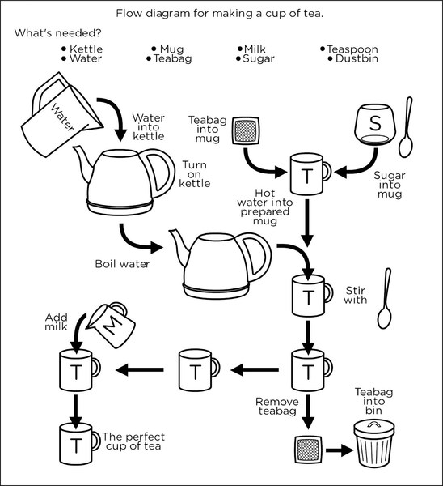

Slide 63
Demo
Notes:
~PythonProjects/github/iancooper/RpcIsEvil/
Make sure that you run virtualenvwrapper to load the python environment first!

Slide 64
Latency
“The most obvious difference between a local object invocation and the invocation of an operation on a remote (or possibly remote) object has to do with the latency of the two calls. The difference between the two is currently between four and five orders of magnitude, and given the relative rates at which processor speed and network latency speeds are changing, the difference in the future promises to be at best no better, and will likely be worse.”
A Note on Distributed Computing, Waldo et al. 1994
Notes:
“Ignoring the difference between the performance of local and remote invocations can lead to designs whose implementations are virtually assured of having performance problems because the design requires a large amount of communication between components that are in different address spaces and on different machines. Ignoring the difference in the time it takes to make a remote object invocation and the time it takes to make a local object invocation is to ignore one of the major design areas of an application. A properly designed application will require determining, by understanding the application being designed, what objects can be made remote and what objects must be clustered together.” – A Note on Distributed Computing

Slide 65

Is my cup of tea being made, or is there an error on the server?
Can I talk to the server right now? Is it busy? Is it gone?
What happens if there is a problem making my cup of tea? How will I know?

Slide 66

What goes in the cup first? Tea or milk?
Perhaps new information leads us to believe our old approach, tea first is not correct, and we should put the milk in first.
But if f the client is the ‘locus of control’, then we have to change all clients to effect this change.
Notes:
The client should not have the expertise about how to make tea. That belongs to the server, it is the ‘expert’ on making tea not the client. We don’t want to have to tell the client if we have a better way of making tea, we just want to serve them better tea.
In OO we call this problem feature envy – our calls to the client to adjust properties or call methods means that the business logic bleeds out into the client rather than being in the server.
We lose information hiding.
Parnas in ‘On the criteria to be used for the decomposition of software into modules’ says: don’t use a flowchart, that is the wrong approach to finding modules, use information hiding as the key to deciding what modules to create. We should not base our programme structure on the steps to make tea, but around information hiding on the process of tea making.

Slide 67

We want to change the algorithm used to make tea, without changing the client.
It’s possible local traditions around tea are different. Perhaps we need to make tea not with milk, but black. We might need to add lemon or rose petals!
So we might want to make a runtime decision on the algorithm to use depending on location!
We would like our server to work in all these circumstances, so the client should not hold behavior.

Slide 68
Work Asynchronously
Synchronous Programming scales poorly
Notes:
Doing Work Asynchronously
There is a problem with request/reply - it scales poorly
- It fails to scale easily because you need to hold a session open between sender and receiver.
- It blocks resources on the sender waiting for resources on the server. The server becomes a bottleneck no matter what resources were available on the client
- It is hard to make reliable because if you lose one participant in the conversation you need to restart.
So we would prefer to try and do work asynchronously were possible to ensure that we make the best use of the resources that we have.
We have lots of options to make ourselves asynchronous such as parallel programming, event driven programming etc.

Slide 69
“Since, in most cases, design decisions transcend time of execution, modules will not correspond to steps in the processing.
On the Criteria To Be Used in Decomposing Systems into Modules – David Parnas
Notes:
We have tried to demonstrate by these examples that it is almost always incorrect to begin the decomposition of a system into modules on the basis of a flowchart. We propose instead that one begins with a list of difficult design decisions or design decisions which are likely to change. Each module is then designed to hide such a decision from the others. Since, in most cases, design decisions transcend time of execution, modules will not correspond to steps in the processing. To achieve an efficient implementation we must abandon the assumption that a module is one or more sub- routines, and instead allow subroutines and programs to be assembled collections of code from various modules.

Slide 70
MESSAGING: HOW TO Make a Good Cup of Tea
“Now this is serious! if there’s one thing in this country that really bothers me/ Its’ the inability of yanks to make a good cup of tea”
T.U.S.A. Masters of Reality.

Slide 71
Demo
Notes:
~PythonProjects/github/iancooper/RpcIsEvil/
Make sure that you run virtualenvwrapper to load the python environment first!

Slide 72


A Command
An Event
Notes:
We may prefer and event to a command when integrating.
A Command says: Do this thing i.e. Make me a cup of tea. This works if the client is there, I will get a cup of tea, but if the client is not I must have used some middleware in the runtime to guarantee at least once delivery. You might also refuse me, perhaps you are busy.
An Event says: Here is the state I am in. Can you help? We are open here to anyone handling it. I don’t care who gets me tea, I just want tea. Some potential tea bringers may be busy, but another one might bring me tea.

Slide 73
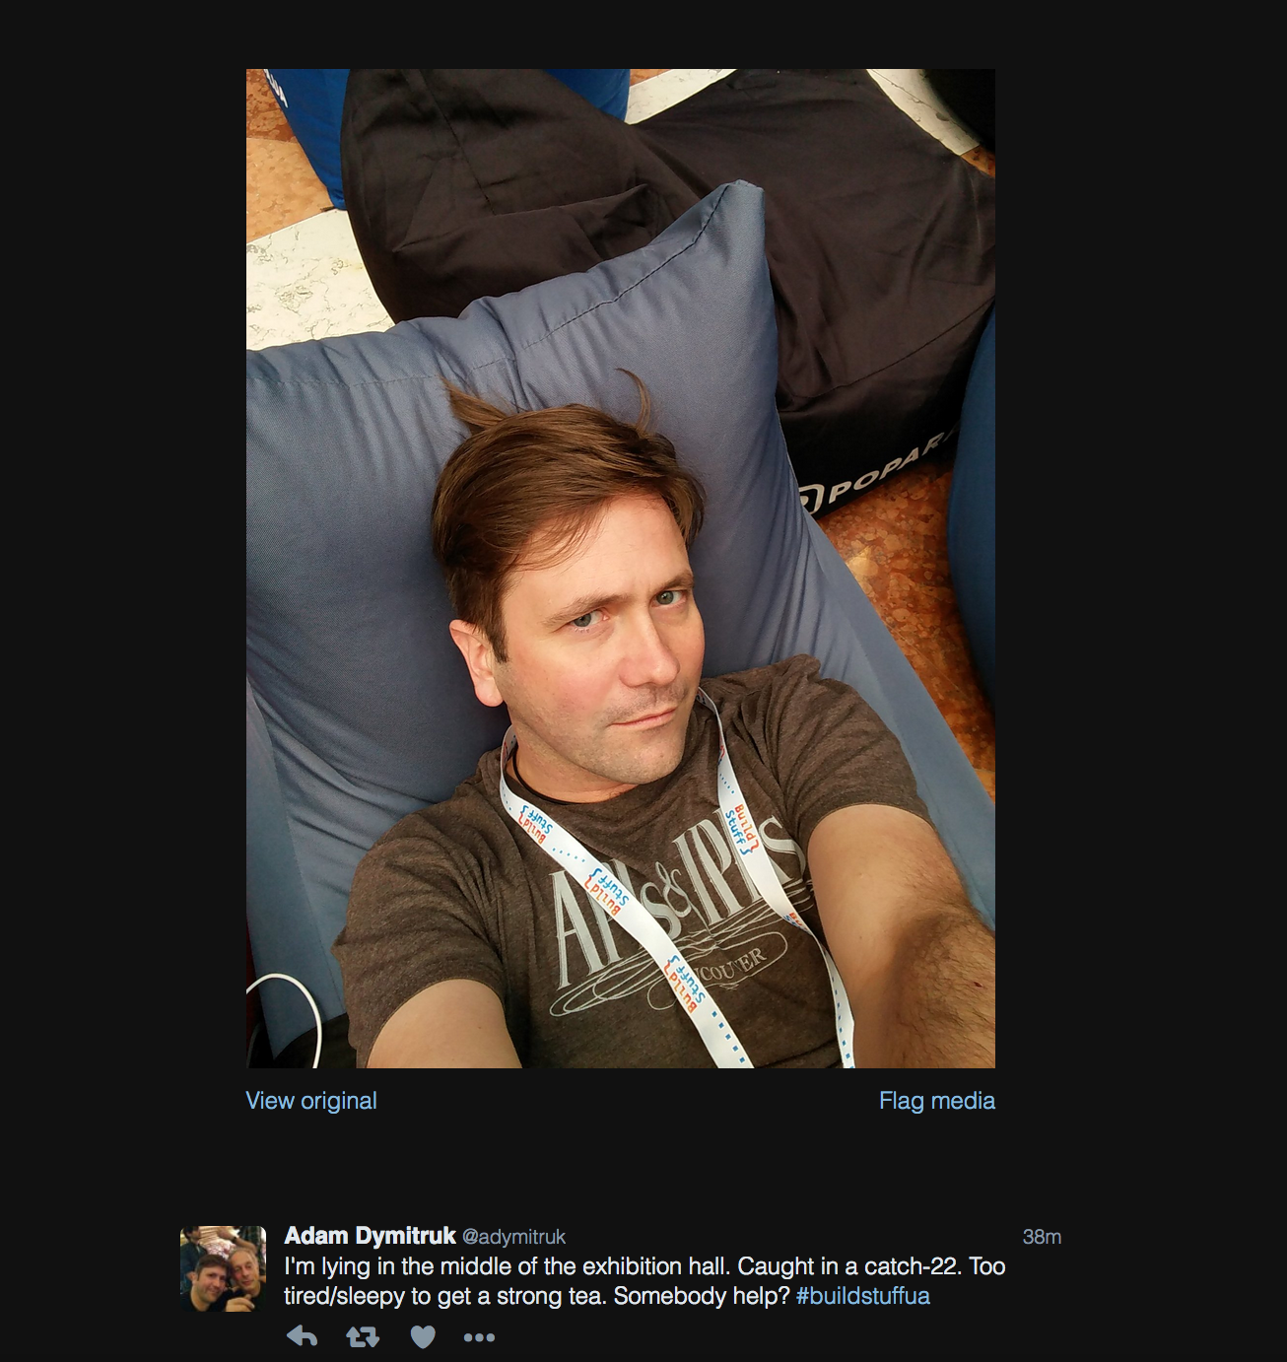

Slide 74
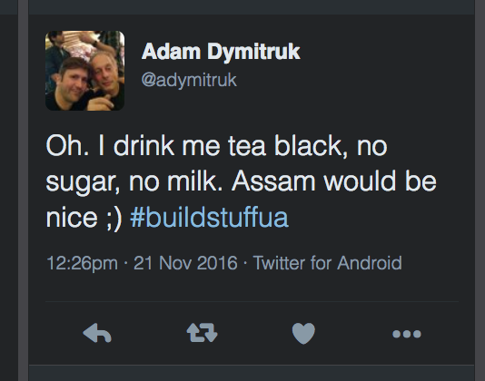

Slide 75
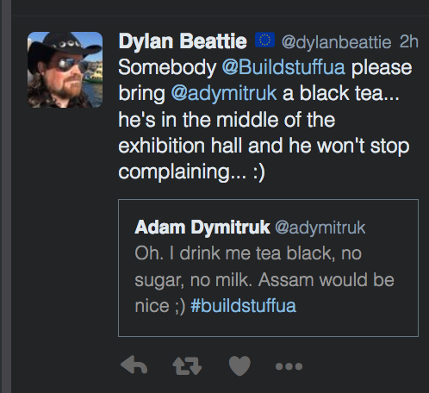

Slide 76
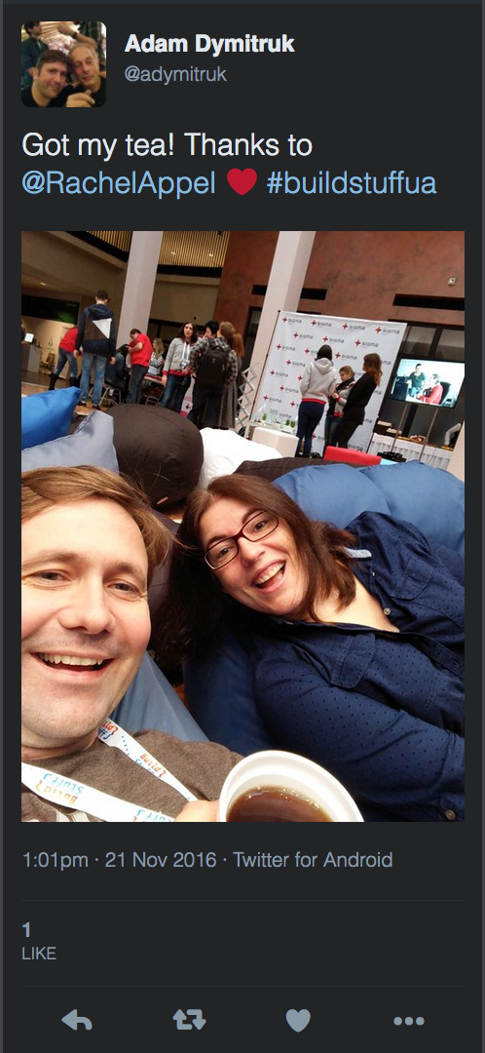

Slide 77
Messaging vs. RPC

Slide 78
Loose Coupling
The core principle behind lose coupling is to reduce the assumptions that two parties (components, applications, services, programs, users) make about each other when they exchange information.
Notes:
Loose Coupling
The core principle behind lose coupling is to reduce the assumptions that two parties (components, applications, services, programs, users) make about each other when they exchange information.
T

Slide 79
Choose a platform-independent, self-describing data format (XML, JSON)
Do not send data to another machine (IP), send it to an addressable channel.
The channel should ‘queue’ requests to remove the temporal coupling of a connection-oriented protocol.
Remove data format dependencies by allowing for the pipeline to include data transformations
Notes:
To remove coupling:
Choose a platform-independent, self-describing data format (XML, JSON)
Do not send data to another machine (IP), send it to an addressable channel.
A channel is a logical address that both sender and receiver can agree on without being aware of each other.
The channel should ‘queue’ requests to remove the temporal coupling of a connection-oriented protocol.
Sender can now continue processing
A queue requires the data to be sent in chunks, or messages, so the channel knows how much to buffer and deliver at once.
Remove data format dependencies but allowing for the pipeline to include data transformations
"Loose coupling provides important benefits such as flexibility and scalability, but it introduces a more complex programming model and can make designing, building, and debugging solutions more difficult.
”

Slide 80
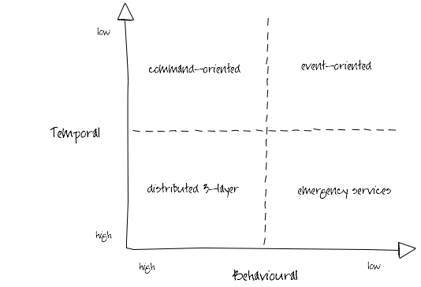
Ian Robinson: http://iansrobinson.com/2009/04/27/temporal-and-behavioural-coupling/
Notes:
Distributed 3-layer
Traditional 3-layer application architecture blown up to distributed proportions. Characterized by call stack-like, imperative behaviour (high temporal and behavioural coupling) and synchronous request-response interactions. Includes systems that layer synchronous interactions on top of asynchronous message exchanges. Senders tell receivers what to do; receivers execute the sender’s orders. Sender and all intermediaries block until the call stack unwinds, effectively locking and/or consuming system resources further up the call chain. This blocking behaviour undermines the autonomy of upstream components and at the same time increases the availability requirements of downstream components. As Michael Nygard’s Release It! reminds us, in these circumstances the availability of the overall system can be no more than that of the least available participant, and the probability of failure is the joint probability of failure in any component or service.
Command-oriented
“Good”, “orthodox” SOA. Low degree of temporal coupling characterized by asynchronous interactions, deferred state and a resumable programming model (process or activity instances are dehydrated between remote invocations in order to conserve resources, and then rehydrated based on correlated responses). Senders typically determine what needs to be done, but rely on receivers to determine how to execute their instructions. This behavioral coupling can require providers to evolve (message formats, supported operations) in lockstep with changing consumer demands.
Event-oriented
Low temporal and behavioral coupling. Receivers determine both what needs to be done and how to do it based on the content of received messages. Resumable programming model: processes are suspended or dehydrated, waiting for events. Can be difficult to trace the execution path of an end-to-end transaction or activity. Exposing an ExtinguishFire operation is a command-oriented way of executing a business process; acting on FireStarted notifications an event-oriented approach.
Emergency services
So called because you tell them what happened, and they decide what to do, but if there’s no one to take your call, you’re hosed. Low behavioural coupling, which allows for the independent evolution of system components, but a degree of temporal coupling, impacting availability requirements of participants. Many RESTful solutions occupy this quadrant. URI-templated solutions have a higher degree of behavioural coupling than hypermedia-driven solutions (where servers constrain and guide what a client can do next, and determine how best to satisfy requests); client polling and caching can mitigate some of these temporal coupling issues.

Slide 81
1.5 Decoupled invocation
The Nature of Messaging, Pros and Cons

Slide 82
Decoupled Invocation
An application may experience peaks of demand that cause it to become overloaded and unable to respond.
It could be that part of the application itself becomes overwhelmed or one of its dependencies becomes overwhelmed.
Notes:
Context and Problem
An application may experience peaks of demand that cause it to become overloaded and unable to respond.
It could be that part of the application itself becomes overwhelmed – due to a lack of CPU or memory – or it could be that the application depends on a third-party service that can become overwhelmed.
For example, there is a limited number of connections in a database connection pool. Long-running queries can lead to a lack of available connections to service requests. These requests in turn back up and overwhelm a server’s thread pool. This can cause queueing of requests on the server. Eventually the server stops serving requests.
“Done well, middleware simultaneously integrates and decouples systems. It integrates them by passing data and events back and forth between the systems. It decouples them by letting the participating systems removing specific knowledge of and calls to the other systems. Since integration points are the number-one cause of instability, this looks like a good thing.”
“Any kind of synchronous call-and-response or request/reply method forces the calling system to stop what it’s doing and wait. In this model, the calling system and the receiving system must both be active at the same time—they are synchronous in time—though they may be in different places. This category covers remote procedure calls (RPC), HTTP, XML-RPC, RMI, CORBA,
DCOM, and any other analog of local method calls. Tightly coupled middleware amplifies shocks to the system. Synchronous calls are particularly vicious amplifiers that facilitate cascading failures.”

Slide 83
DIAGRAM: Have a service A that calls B that calls a Db. Next picture service Db faults due to connection pool limit. B faults due to queueing waiting for the Db. A faults waiting for B. Now show a queue between A and B. Show that B can throttle the rate it reads from the queue to stay within limit of the Db connection pool.

Slide 84
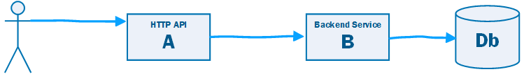

Slide 85
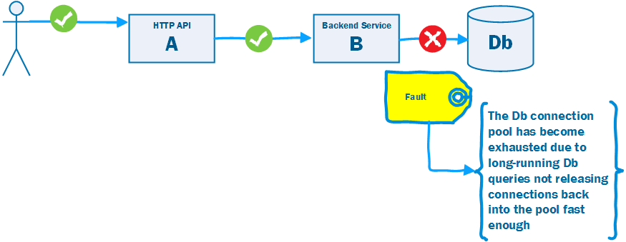

Slide 86
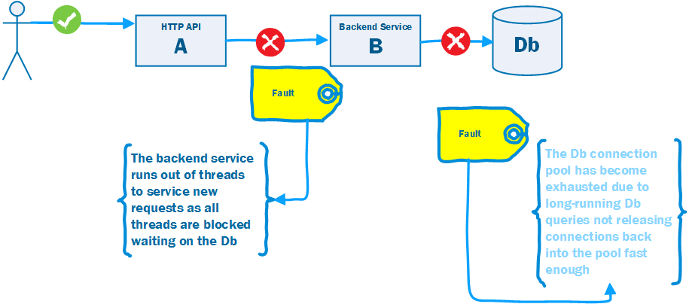

Slide 87
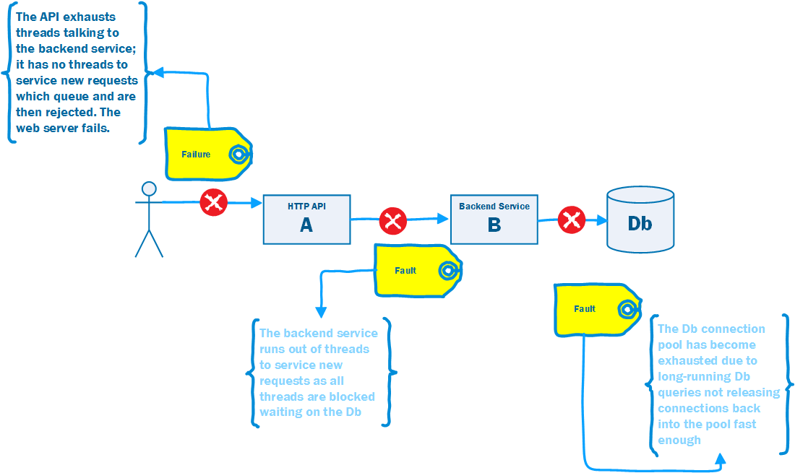

Slide 88
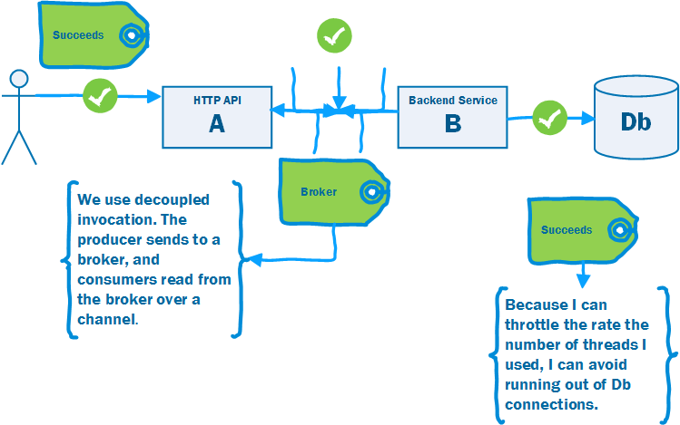

Slide 89
Decoupled Invocation Pattern
Use Decoupled Invocation. A producer puts a message onto a queue at the service endpoint. A consumer reads messages from the queue.
The queue stores messages for eventual processing. If the queue is durable we gain guaranteed delivery, and at-least once guarantees.
If the rate of arrival at the endpoint is unpredictable, the queue acts as a buffer that makes it possible to predict the rate of consumption.
This makes it simpler to do capacity planning because peaks of requests are smoothed out by the queue.
The consumer must be able to control the rate of processing, otherwise a spike is simply passed down the wire.
Notes:
As illustrated in figure 3.3, the Decoupled Invocation pattern is composed of three basic components: a handler, a queue, and a dispatcher that mediates between them. Here’s how the initial request processing works:
The handler listens for incoming requests from the endpoint.
When a new request arrives, the handler sends an acknowledgment to the sender.
The handler is responsible for the initial treatment, or preprocessing, of incoming messages. This may include message transformation or prioritization based on knowledge it infers from the messages themselves. Overall, this processing should be kept minimal, as the goal is to quickly queue and acknowledge incoming requests.
The message is put onto a queue.
The queue, which is the second component of the Decoupled Invocation pattern, stores incoming messages and allows the service to consume the messages at its own steady rate, thus overcoming peak loads.
You can set up the queue to be persistent so the service won’t lose any requests it has already acknowledged, even if a catastrophic server failure occurs. If the queue is transactional, you can also implement the Transactional Service pattern (see chapter 2) and increase the overall robustness of the service even further.
The dispatcher is responsible for creating as many reader components as are needed for the current request load, which is measured by the number of messages waiting in the queue. The dispatcher can also prioritize incoming tasks based on internal considerations, such as resource availability. The dispatcher is a good place to introduce elasticity if the latency of handling the messages is important. (See also the further reading section for an article on the LMAX architecture, which describes a low-latency, high-performance queue between senders and receivers.)
The handler can acknowledge the request as part of the preprocessing, but it’s usually best to do this inside an edge component (see the Edge Component pattern in chapter 2). This helps ensure that the service-processing load is kept to a minimum, allowing the handler to process requests as efficiently as possible.
Placing requests on the queue is a relatively low-cost operation that can be performed efficiently, making the initial request-handling less susceptible to failure during peaks (as compared to other parts of the request-handling that require more time and resources). The actual handling of the incoming requests can be performed at a reasonable pace, dictated by service resource availability and overall load. Load balancing can be achieved by running multiple readers against the queue.

Slide 90
Work Queue Pattern
A common distributed system (as opposed to integrated system) pattern.
A web site needs to respond < 250ms to scale. But some requests take longer…
Use decoupled invocation to put the work on a queue, offloading the long-running tasks, allowing the web server to respond in time.
202 Accepted and provide location to monitor for completion.

Slide 91
2. Fundamental messaging patterns
How to do Messaging

Slide 92
2.1 types of messages

Slide 93
Message Construction
A message has a header and body
Message Intent: Command, Document, Event
Request-Reply: needs Return Channel and Correlation Identifier
Break a large message into pieces as a Message Sequence
Slow messages: One way to deal with eventual consistency is to create a Message Expiry
Notes:
Messages 5m
- Two processes communicating need to copy the data between processes - usually as a stream of bytes. We need to break up this stream into discrete units so that we can tell when a message on the channel begins and ends. Otherwise we could not use competing consumers to read messages from the stream or publish to multiple subscribers
- A message has a header, how to process and a body, the content
- Three types: Command (invoke), Document (share data), Event (notify of change)
- The difference between event and document are that with document the emphasis on the content of the message, with an event the emphasis is on the occurrence itself.
Message Intent: Command, Document, Event
Request-Reply: (Usually Command-Document), tends to use Return Address and Correlation Identifier
In essence RPC over messaging
Break a large message into pieces with Message Sequence
Slow messages: One way to deal with eventual consistency is to create a Message Expiry, and if a message is not delivered within a time-window delete or add to Dead Letter Queue
Message: An atomic packet of data transmitted on a channel
Messaging transmits discrete units of data by marshalling the data from the sender and unmarshalling it in the receiver so that the receiver has its own local copy.
Data to be sent must be converted into one of more messages that can be sent
A message has two basic parts: header (metadata used by the messaging system); body (the payload used by the receiver).
Command Message: Invoke a procedure in another application
Document Message: Pass data to another application
Event Message: Notify another application about a change
Request-Reply: The sender expects a reply
Message Sequence: Split a message into parts; receive before Message Expiration
Canonical Data Format: The body format to be understood by producer and consumer

Slide 94
Command Message
Use a Command Message to reliably invoke a procedure in another application
Uses the well-established pattern for encapsulating a request as an object. The Command pattern [GoF] turns a request into an object that can be stored and passed around.
Notes:
Command Message: Use a Command Message to reliably invoke a procedure in another application. The advantage o f Remote Procedure Invocation is that it’s synchronous, so the call is performed immediately while the caller’s thread blocks. But that’s also a disadvantage. If the call cannot be executed immediately— either because the network is down or because the remote process isn’t running and listening— then the call doesn’t work. If the call were asynchronous, it could keep trying until the procedure in the remote application is successfully invoked. There’s a well-established pattern for encapsulating a request as an object. The Command pattern [GoF] shows how to turn a request into an object that can be stored and passed around. If this object were a message, then it could be stored in and passed around through a Message Channel (60). Likewise, the command’s state (such as method parameters) can be stored in the message’s state. Usually sent over a Point-to-Point channel as there is only one consumer.

Slide 95
Document Message
Use a Document Message to reliably transfer a data structure between applications.
The receiver decides what, if anything, to do with the data
Notes:
Document Message: Use a Document Message to reliably transfer a data structure between applications. Whereas a Command Message tells the receiver to invoke certain behavior, a Document Message just passes data and lets the receiver decide what, if anything, to do with the data. The data is a single unit of data, a single object or data structure that may decompose into smaller units. Guaranteed Messaging may be appropriate, but not Message Expiration.

Slide 96
Event Message
Use an Event Message for reliable, asynchronous event notification between applications.
The difference between an Event Message and a Document Message is a matter of timing and content. An event’s contents are typically less important.
Notes:
Event Message: Several applications would like to use event notification to coordinate their actions and would like to use Messaging (53) to communicate those events. Use an Event Message for reliable, asynchronous event notification between applications. The difference between an Event Message and a Document Message (147) is a matter of timing and content. An event’s contents are typically less important. Many events even have an empty message body; their mere occurrence tells the observer to react. An event’s timing is very important; the subject should issue an event as soon as a change occurs, and the observer should process it quickly while it’s still relevant.

Slide 97


I have a local cache of the other services data, that I can use to service requests
Credit Card
Payments
Push
Not
Pull
API
Bookings
Reference
Cache
Credit Card
Payments
API
Payments
Db
I receive a Document Message that contains the data required to process event
Payments
Db
Notes:
Push model— The message is a combined document/ event message; the message’s delivery announces that the state has occurred and the message’s contents are the new state. This is more efficient if all observers want these details, but otherwise it can be the worst of both worlds: a large message that is sent frequently and often ignored by many observers.
Pull model— There are three messages: 1. Update is an Event Message that notifies the observer of the event. 2. State Request is a Command Message an interested observer uses to request details from the subject. 3. State Reply is a Document Message the subject uses to send the details to the observer.
Reference Data— Pat Helland Data on the Outside vs Data on the Inside

Slide 98
Request-Reply
When an application sends a message, how can it get a response from the receiver?
Send a pair of Request-Reply messages, each on its own channel.
Synchronous Block: Sender blocks whilst polling for reply.
Asynchronous Callback: A separate thread listens for reply messages.
Notes:
Request-Reply: When an application sends a message, how can it get a response from the receiver? Send a pair of Request-Reply messages, each on its own channel.
Synchronous Block: Sender blocks whilst polling for reply. Simple to implement, lower reliability, ties up thread waiting for response
Asynchronous Callback: A separate thread listens for reply messages. Harder to implement for timing issues, more reliable, removes temporal coupling and resource wastage

Slide 99
The request message should contain a Return Address that indicates where to send the reply message
Each reply message should contain a Correlation Identifier, a unique identifier that indicates which request message this reply is for.
Notes:
Message needs Reply Address, must have Correlation Identifier to sender and receiver
Return Address: The request message should contain a Return Address that indicates where to send the reply message. Makes it easier to change than hard-coding response channel into receiver
Correlation Identifier: Each reply message should contain a Correlation Identifier, a unique identifier that indicates which request message this reply is for. This is how a Correlation Identifier works: When the requestor creates a request message, it assigns the request a request ID— an identifier that is different from those for all other currently outstanding requests, that is, requests that do not yet have replies. When the replier processes the request, it saves the request ID and adds that ID to the reply as a correlation ID. When the requestor processes the reply, it uses the correlation ID to know which request the reply is for. This is called a Correlation Identifier because of the way the caller uses the identifier to correlate (i.e., match; show the relationship) each reply to the request that caused it.

Slide 100
Message Sequence
Whenever a large set of data needs to be broken into message-size chunks, send the data as a Message Sequence
Sequence identifier— Distinguishes this cluster of messages from others.
Size or End indicator— Specifies the number of messages
Position identifier— Uniquely identifies and sequentially orders each message in a sequence.
Notes:
Message Sequence: Whenever a large set of data needs to be broken into message-size chunks, send the data as a Message Sequence and mark each
The three Message Sequence identification fields are as follows.
Sequence identifier— Distinguishes this cluster of messages from others.
Position identifier— Uniquely identifies and sequentially orders each message in a sequence.
Size or End indicator— Specifies the number of messages in the cluster or marks the last message in the cluster (whose position identifier then specifies

Slide 101
Message Sequence is not compatible with Competing Consumers

Slide 102
Useful Properties
Message Expiration: specify a time limit for how long the message is viable.
Format Indicator: An indicator of schema and/or version
Notes:
Message Expiration: Message Expiration to specify a time limit for how long the message is viable.
Format Indicator: How can a message’s data format be designed to allow for possible future changes? Design a data format that includes a Format Indicator so that the message specifies what format it is using.
Version Number— A number or string that uniquely identifies the format. Both the sender and receiver must agree on which format is designated by a particular indicator. The advantage of this approach is that the sender and receiver do not have to agree on a shared repository for format descriptors, but the drawback is that each must know what descriptor is indicated and where to access it.
Foreign Key— A unique ID— such as a filename, a database row key, a home primary key, or an Internet URL— that specifies a format document. The sender and receiver must agree on the mapping of keys to documents and the format of the schema document. The advantage of this approach is that the foreign key is very compact and can point to a detailed data format description in a shared repository. The main drawback lies in the fact that each messaging participant has to retrieve the format document from a potentially remote resource.
Format Document— A schema that describes the data format. The schema document does not have to be retrieved via a foreign key or inferred from a version number; it is embedded in the message. The sender and the receiver must agree on the format of the schema. The advantage of this alternative is that messages are self-contained. However, message traffic increases because each message carries format information that rarely changes.

Slide 103
2.2 channels

Slide 104
Channels
A virtual pipe that connects producer and consumer
Messaging is not a ‘bucket’. A consumer can filter according to the type of information it wants
Logical Address
Unidirectional
One-to-one or One to Many
Notes:
What is a channel?
Logical Address: Channels are logical addresses in a messaging system. The details of implementation are hidden from applications using the channel, they just need to know how to address the channel.
Channel: A virtual pipe that connects sender to receiver.
A messaging system is not implemented as a bucket. A receiver knows what type of information it wants, and the sender can identify what it is
A sender sends to a particular channel and a receiver reads from a particular channel
Channels are logical addresses in the MOM
Implementation details such as messages are stored on sender and receiver or in a distributed database are hidden from the user
The application or administrator has to create them, they are not pre-configured
Point-to-point channels and publish-subscribe channels
Datatype channels avoid the confusion of mixing data types over one channel; Selective Consumer allows multiplexing channels
Invalid Message Channel — a channel for messages that could not be consumed
Unidirectional—we don’t want to consumer our own messages; use Request-Reply for bi-directional flow (sender indicates return channel)
Often fixed set, especially for more complex topologies
One-to-one (Point-to-point Channel) or One to Many (Publish-Subscribe Channel)
Type: Use a DataType Channel - everything on the channel is the same type. Favour many channels over the receiver interpreting the type and deciding how to route it internally.
Invalid messages: the receiver cannot ‘read’ the message successfully to process it, goes on invalid message channel; if MOM cannot deliver to a consumer, sends to dead-letter channel
By default messages are stored in memory, Guaranteed Delivery means that the message is stored to disk and will survive a crash; availability vs. performance trade-off

Slide 105
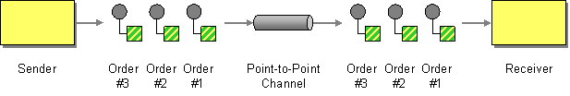
Point-to-Point Channel
http://www.enterpriseintegrationpatterns.com/patterns/messaging/PointToPointChannel.html
Notes:
How can the caller be sure that exactly one receiver will receive the document or perform the call?
Send the message on a Point-to-Point Channel, which ensures that only one receiver will receive a particular message.
A Point-to-Point Channel ensures that only one receiver consumes any given message. If the channel has multiple receivers, only one of them can successfully consume a particular message. If multiple receivers try to consume a single message, the channel ensures that only one of them succeeds, so the receivers do not have to coordinate with each other. The channel can still have multiple receivers to consume multiple messages concurrently, but only a single receiver consumes any one message.
Send a Command on a Point-to-Point channel to ensure only one receiver will receive a particular message; if there are Competing Consumers only one will read any message

Slide 106
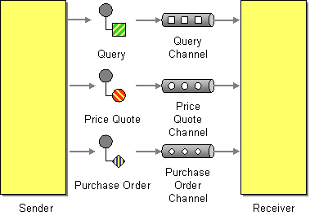
Datatype Channel
http://www.enterpriseintegrationpatterns.com/patterns/messaging/DatatypeChannel.html
Notes:
An application is using Messaging to transfer different types of data, such as different types of documents.
How can the application send a data item such that the receiver will know how to process it?
Use a separate Datatype Channel for each data type, so that all data on a particular channel is of the same type.
By using a separate Datatype Channel for each type of data, all of the messages on a given channel will contain the same type of data. The sender, knowing what type the data is, will need to select the appropriate channel to send it on. The receiver, knowing what channel the data was received on, will know what its type is.
The receiver must know what type of messages it is receiving or it won’t know how to process them. Use a separate Datatype Channel for each datatype so that all the data on a particular channel is of the same type.

Slide 107
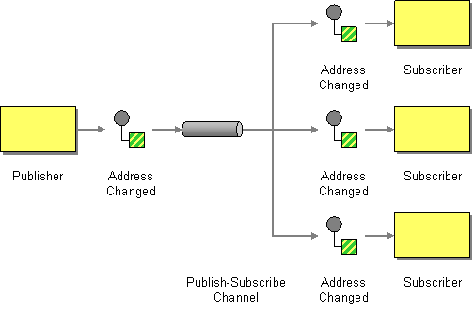
Publish-Subscribe Channel
http://www.enterpriseintegrationpatterns.com/patterns/messaging/PublishSubscribeChannel.html
Notes:
An application is using Messaging to announce events.
How can the sender broadcast an event to all interested receivers?
Send the event on a Publish-Subscribe Channel, which delivers a copy of a particular event to each receiver.
A Publish-Subscribe Channel works like this: It has one input channel that splits into multiple output channels, one for each subscriber. When an event is published into the channel, the Publish-Subscribe Channel delivers a copy of the message to each of the output channels. Each output channel has only one subscriber, which is only allowed to consume a message once. In this way, each subscriber only gets the message once and consumed copies disappear from their channels.
Send an event on a Publish-Subscribe Channel which delivers a copy to all receivers; also allows eavesdropping on a message; a firehose of all channels can act like a message store

Slide 108
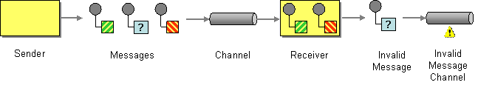
Invalid Message Channel
http://www.enterpriseintegrationpatterns.com/patterns/messaging/InvalidMessageChannel.html
Notes:
An application is using Messaging to receive Messages.
How can a messaging receiver gracefully handle receiving a message that makes no sense?
The receiver should move the improper message to an Invalid Message Channel, a special channel for messages that could not be processed by their receivers.
When designing a messaging system for applications to use, the administrator will need to define one or more Invalid Message Channels for the applications to use.
Where the message cannot be interpreted by the receiver even if well-formed i.e. is missing headers, or the body has an unexpected content type or does not match the expected schema. Although the MOM has delivered the message to the receiver it cannot be passed to application code to process. In this case the message is sent to an Invalid Message Channel a special channel for messages that could not be processes by their receivers. Messages that cause application errors, but are well formed, should not be placed on the Invalid Message Channel—treat them as application errors. If using a Service Activator or Messaging Gateway then errors in the message handling framework should be passed on to the Invalid Message Channel, but errors in the application code should not. It usually indicates an integration problem either in code or configuration.

Slide 109
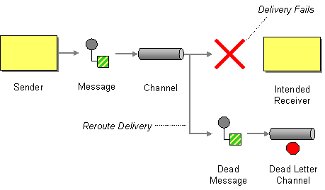
Dead Letter Channel
http://www.enterpriseintegrationpatterns.com/patterns/messaging/DeadLetterChannel.html
Notes:
An enterprise is using Messaging to integrate applications.
What will the messaging system do with a message it cannot deliver?
When a messaging system determines that it cannot or should not deliver a message, it may elect to move the message to a Dead Letter Channel.
The specific way a Dead Letter Channel works depends on the specific messaging system’s implementation, if it provides one at all. The channel may be called a “dead message queue” [Monson-Haefel, p.125] or “dead letter queue.” [MQSeries], [Dickman, pp.28-29] Typically, each machine the messaging system is installed on has its own local Dead Letter Channel so that whatever machine a message dies on, it can be moved from one local queue to another without any networking uncertainties. This also records what machine the message died on. When the messaging system moves the message, it may also record the original channel the message was supposed to be delivered on.
When a messaging system determine that it cannot or should not deliver a message, it may elect to move the message to a dead-letter channel.

Slide 110
Quality of Service Channel
http://www.enterpriseintegrationpatterns.com/patterns/messaging/PointToPointChannel.html
Notes:
If some parts our application are missing critical we may have different characteristics for them in terms of durability, removing non-priority jobs etc. These QoS aspects should mean a different channel where they vary.

Slide 111
2.3 endpoints

Slide 112
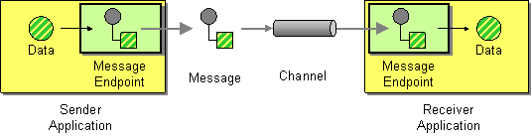
Message Endpoint
http://www.enterpriseintegrationpatterns.com/patterns/messaging/MessageEndpoint.html
Notes:
Applications are communicating by sending Messages to each other via Message Channels.
How does an application connect to a messaging channel to send and receive messages?
Connect an application to a messaging channel using a Message Endpoint, a client of the messaging system that the application can then use to send or receive messages.
Message Endpoint code is custom to both the application and the messaging system’s client API. The rest of the application knows little about message formats, messaging channels, or any of the other details of communicating with other applications via messaging. It just knows that it has a request or piece of data to send to another application, or is expecting those from another application. It is the messaging endpoint code that takes that command or data, makes it into a message, and sends it on a particular messaging channel. It is the endpoint that receives a message, extracts the contents, and gives them to the application in a meaningful way.

Slide 113
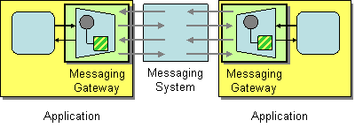
Messaging Gateway
http://www.enterpriseintegrationpatterns.com/patterns/messaging/MessagingGateway.html
Notes:
An application accesses another system via Messaging.
How do you encapsulate access to the messaging system from the rest of the application?
Use a Messaging Gateway, a class than wraps messaging-specific method calls and exposes domain-specific methods to the application.
The Messaging Gateway encapsulates messaging-specific code (e.g., the code required to send or receive a message) and separates it from the rest of the application code. This way, only the Messaging Gateway code knows about the messaging system; the rest of the application code does not. The Messaging Gateway exposes a business function to the rest of the application so that instead of requiring the application to set properties like Message.MessageReadPropertyFilter.AppSpecific, a Messaging Gateway exposes methods such as GetCreditScore that accept strongly typed parameters just like any other method. A Messaging Gateway is a messaging-specific version of the more general Gateway pattern [EAA].

Slide 114
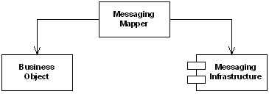
Messaging Mapper
http://www.enterpriseintegrationpatterns.com/patterns/messaging/MessagingMapper.html
Notes:
A Messaging Mapper converts domain objects into a message as required by the messaging channel.
It also provides the reverse capability, create or update a domain objects based on an incoming messages.
Because of this mediator, the domain does not need to know about messaging formats and vice-versa
When integrating applications using messaging, the data inside a message is often derived from domain objects inside the integrated applications. If we use a Document Message, the message itself may directly represent one or domain objects. If we use a Command Message, some of the data fields associated with the command are likely to be extracted from domain objects as well. There are some distinct differences between messages and objects. For example, most objects rely on associations in the form of object references and inheritance relationships. Many messaging infrastructures do not support these concepts because they have to be able to communicate with a range of applications, some of which may not be object-oriented at all.
How do you move data between domain objects and the messaging infrastructure while keeping the two independent of each other?
Create a separate Messaging Mapper that contains the mapping logic between the messaging infrastructure and the domain objects. Neither the objects nor the infrastructure have knowledge of the Messaging Mapper's existence.
The Messaging Mapper accesses one or more domain objects and converts them into a message as required by the messaging channel. It also performs the opposite function, creating or updating domain objects based on incoming messages. Since the Messaging Mapper is implemented as a separate class that references the domain object(s) and the messaging layer, neither layer is aware of the other. The layers don't even know about the Messaging Mapper.

Slide 115
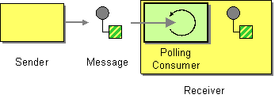
Polling Consumer
http://www.enterpriseintegrationpatterns.com/patterns/messaging/PollingConsumer.html
Notes:
An application needs to consume Messages, but it wants to control when it consumes each message.
How can an application consume a message when the application is ready?
The aplication should use a Polling Consumer, one that explicitly makes a call when it wants to receive a message.
This is also known as a synchronous receiver, because the receiver thread blocks until a message is received. We call it a Polling Consumer because the receiver polls for a message, processes it, then polls for another. As a convenience, messaging API’s usually provide a receive method that blocks until a message is delivered, in addition to methods like receiveNoWait() and Receive(0) that return immediately if no message is available. This difference is only apparent when the receiver is polling faster than messages are arriving.

Slide 116

Event Driven Consumer
http://www.enterpriseintegrationpatterns.com/patterns/messaging/EventDrivenConsumer.html
Notes:
An application needs to consume Messages as soon as they’re delivered.
How can an application automatically consume messages as they become available?
The application should use an Event-Driven Consumer, one that is automatically handed messages as they’re delivered on the channel.
This is also known as an asynchronous receiver, because the receiver does not have a running thread until a callback thread delivers a message. We call it an Event-Driven Consumer because the receiver acts like the message delivery is an event that triggers the receiver into action.

Slide 117
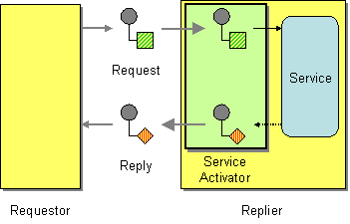
Service Activator
http://www.enterpriseintegrationpatterns.com/patterns/messaging/MessagingAdapter.html
Notes:
An application has a service that it would like to make available to other applications.
How can an application design a service to be invoked both via various messaging technologies and via non-messaging techniques?
Design a Service Activator that connects the messages on the channel to the service being accessed.
A Service Activator can be one-way (request only) or two-way (Request-Reply). The service can be as simple as a method call—synchronous and non-remote—perhaps part of a Service Layer [EAA]. The activator can be hard-coded to always invoke the same service, or can use reflection to invoke the service indicated by the message. The activator handles all of the messaging details and invokes the service like any other client, such that the service doesn’t even know it’s being invoked through messaging.

Slide 119

Further Reading

Slide 120
Q&A

